Slide 1
AI based motion control combination of RRT and collision detection and path replanning
12.31 Jin Lexuan

Slide 2
Combined with RRT
In previous work, RRT path planning works independently, and collision detection and path replanning are performed in test environment.
This week, this two part are combined.
2 path generated by RRT as the input of collision detection and path replanning
Since RRT algorithm has randomness, so the results may be different at different running times.

Slide 3
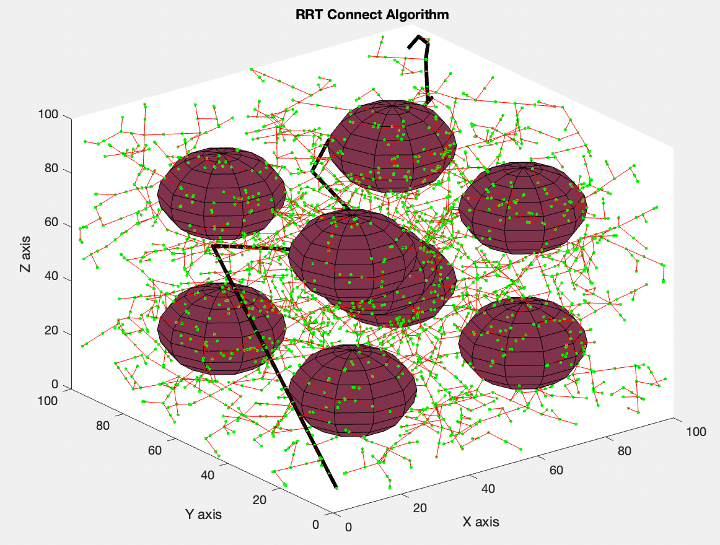
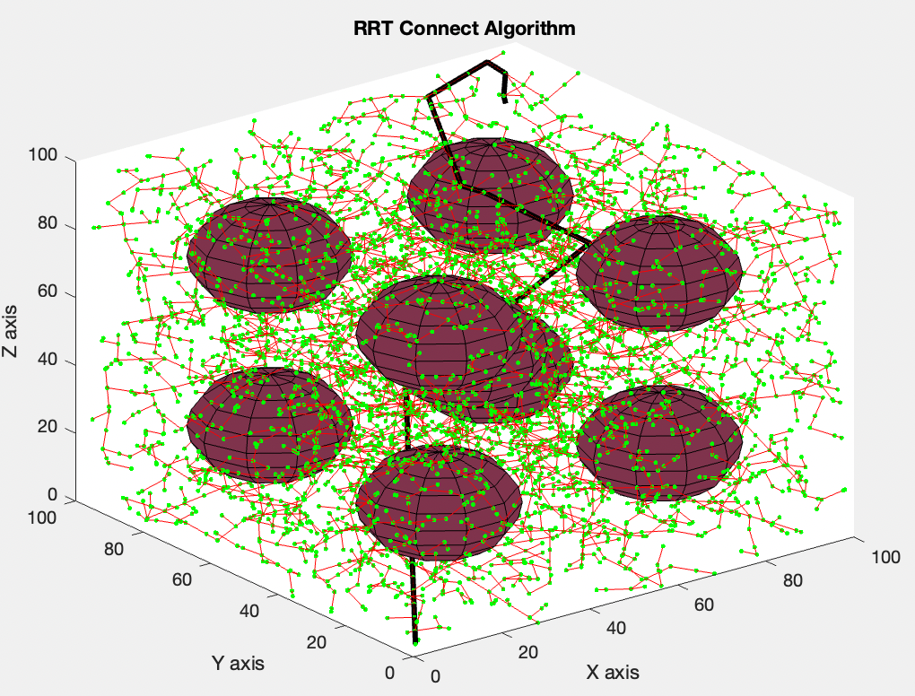
RRT planning
RRT path1 RRT path2

Slide 4
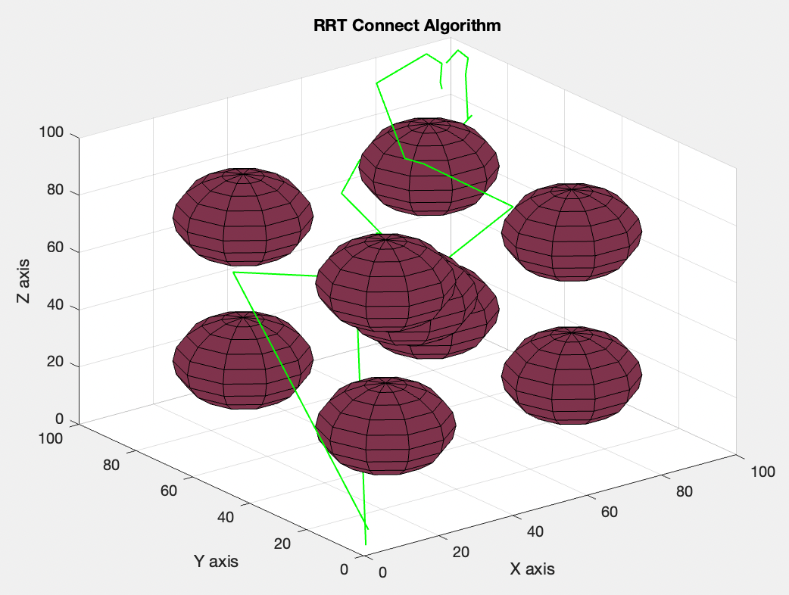
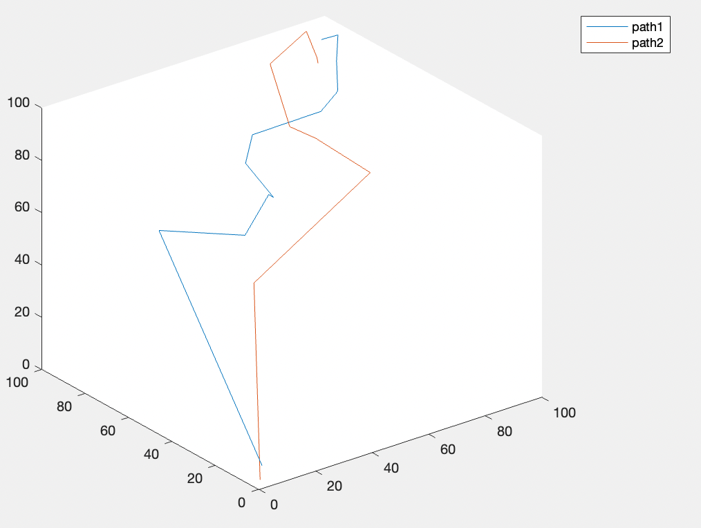
Path extraction for collision detection

Slide 5
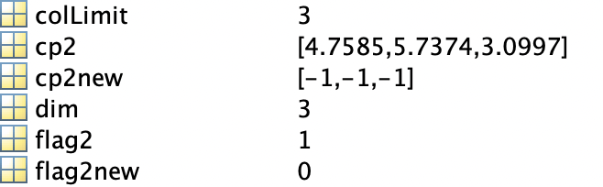
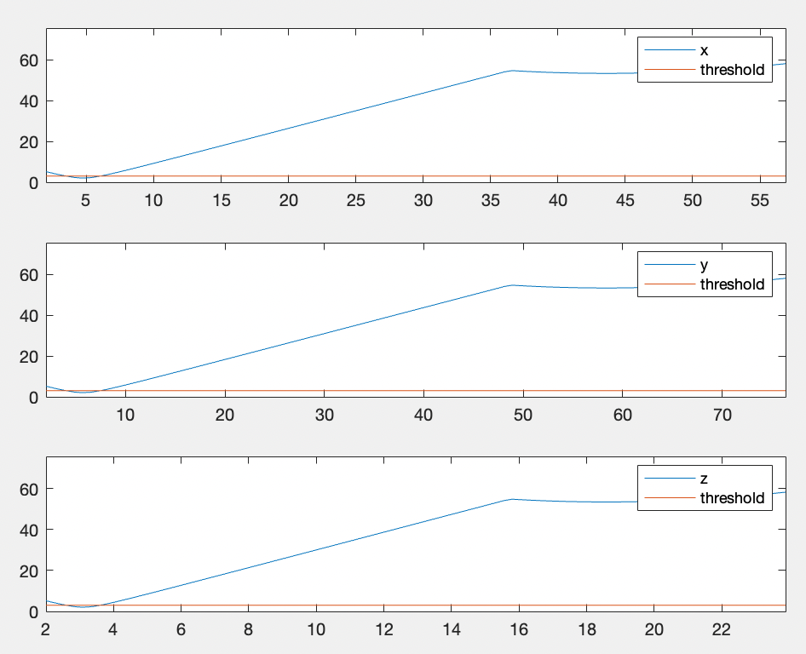
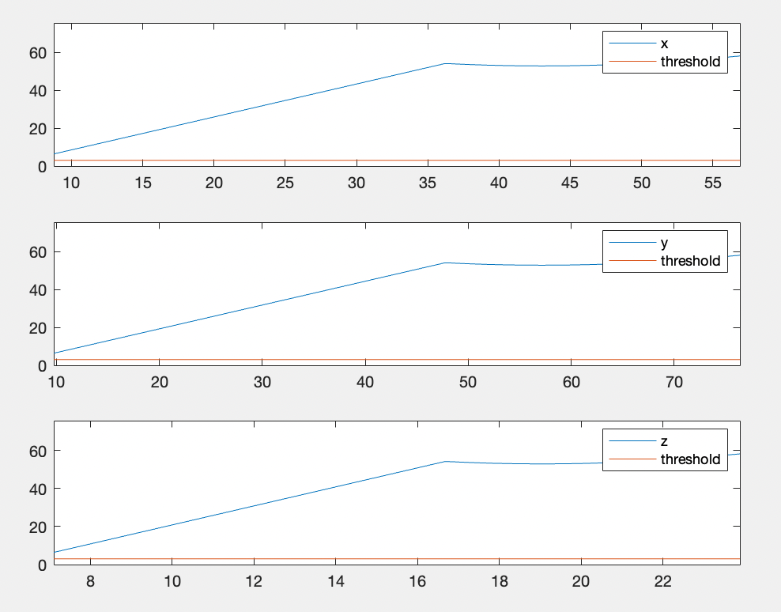
Replanning Result & Distance visualization

Slide 6
Future work
Improve the algorithm for a faster speed.
Draw trajectory for multi-UAVs(time-based)
Add more UAVs to show the performance.
Change the start and end point for UAVs to test
Make the 3D map more complex(e.g. irregular obstacles) to verify the method

